Slide 1
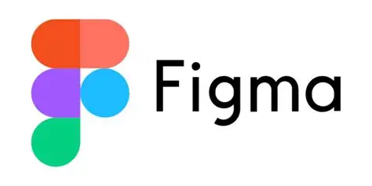
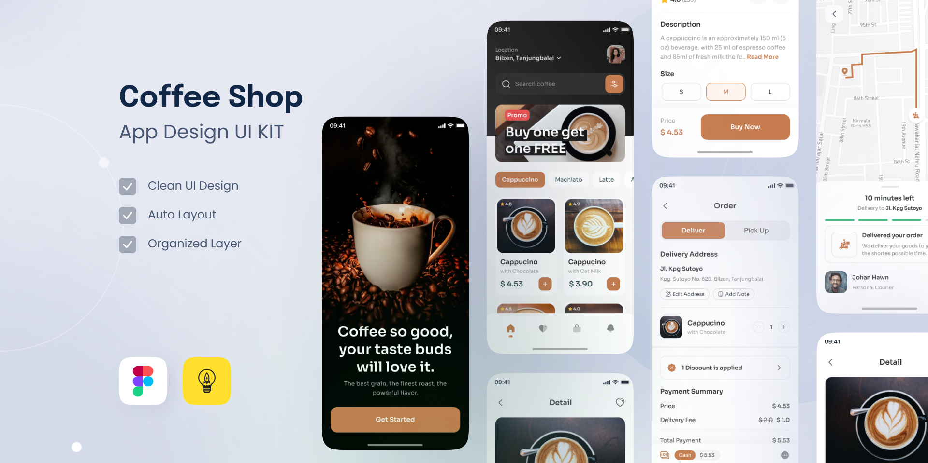
Images Adapted From:
Stick PNG - https://www.stickpng.com/img/icons-logos-emojis/tech-companies/figma-logo
Figma - Mobile APP Prototype | Figma

Slide 2

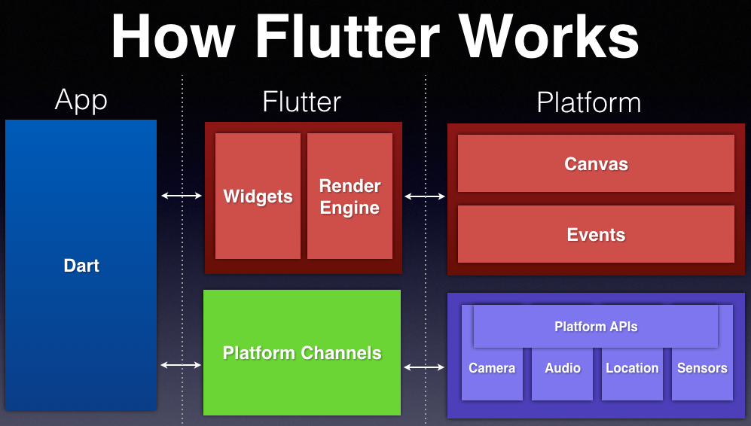
Images Adapted From:
Vrogue - How To Install And Setup Flutter For App Development On Wind

Slide 3


Images Adapted from: Viitorcloud - 10 reasons to use react native framework for mobile app development Blockchain Simplified - Is React Native the Best Framework for Cross Platform Mobile Development? | Blockchain Simplified

Slide 4
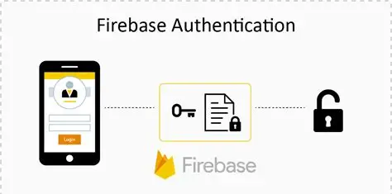

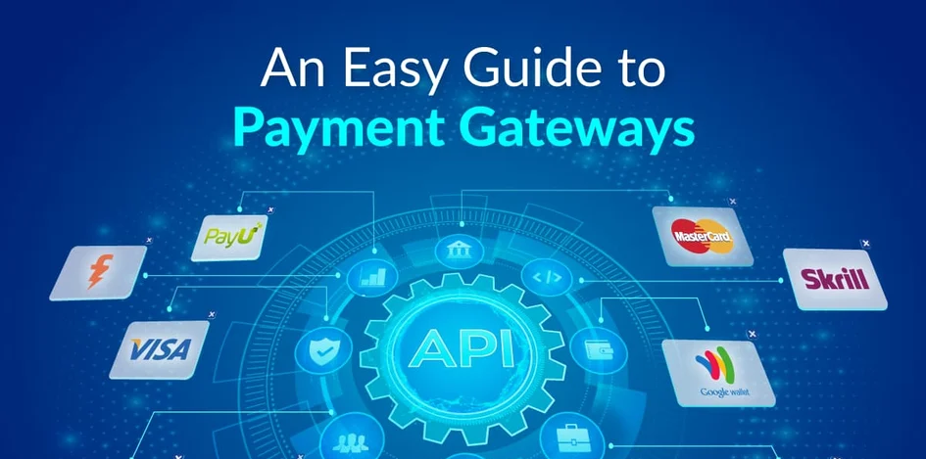
Images Adapted From: InnovationM - Firebase Authentication in iOS - InnovationM Blog TenTen.vn - Google Maps API là gì? 04 bước tạo Google Maps API KMS Solutions - Payment Gateways: Main Types, How They Work and Examples
BackEnd Functionality:
Authentication
Payments
Live Order Tracking

Slide 5

SipRoute Coffee App Prototype
Team:
Kristen Keve (ST10472683)
Kandyce Smit (ST10467645)
Protype Designed on Figma
Figma - Coffee App Prototype – Figma
Thank you for watching !!!!!

